Slide 1





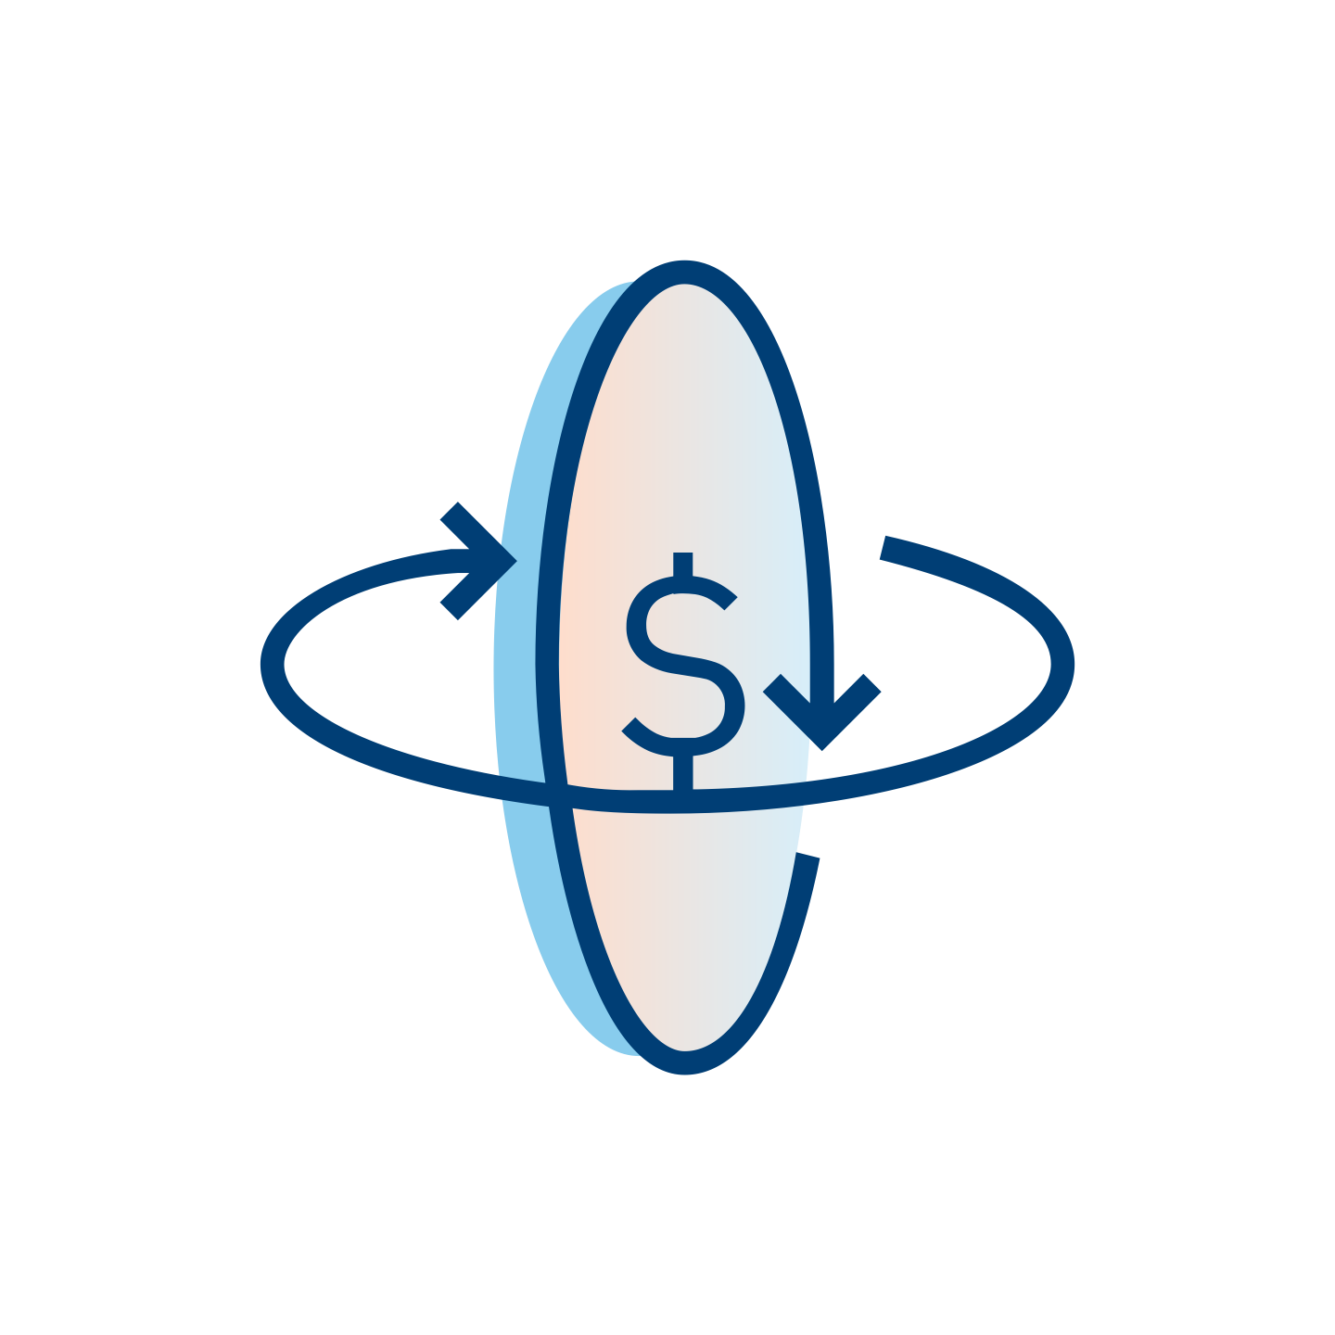
Digital Engagement: Unblu
Universal Banking
Corporate
Banking
Unblu inc. is a Switzerland-based company with other offices in US, Germany, Czech Republic, and Asia. It specializes in web customer collaboration and engagement software and has a co-browsing solution that brings the dynamics of in-person interaction to the online channels.
Value proposition
Key facts
We allow our customers to be in their clients’ pocket. Our platform is a game-changer for wealth clients. Instead of leaving them “alone” in a self-service digital experience, the advisor is at their service when and how they need it.
Deliver added value over time (ideas to trade) as your advisors maintain a close relationship and proximity with clients, that has a direct impact in the increase of AUM.
We help you to increase the efficiency of your staff helping them to spend more client-facing time (x4).
We enable wealth management institutions to provide/build digital experiences that will make the new generation stay when they inherit the money.
Steer exchanges away from wildy adopted B2C applications (like WhatsApp) by matching their Interfaces for a smooth adoption (for users/RMs) and increased compliance (for your organization, e.g. conversation recording for MiFID II)
2008 Year Founded
160+ banks and financial institutes have integrated Unblu into their core systems
50% reduction in average call duration, while improving customer satisfaction.
20% increase on conversion rate outbound call to meeting.
Product Compatibility
Temenos Infinity
Temenos
Payments

