Slide 1
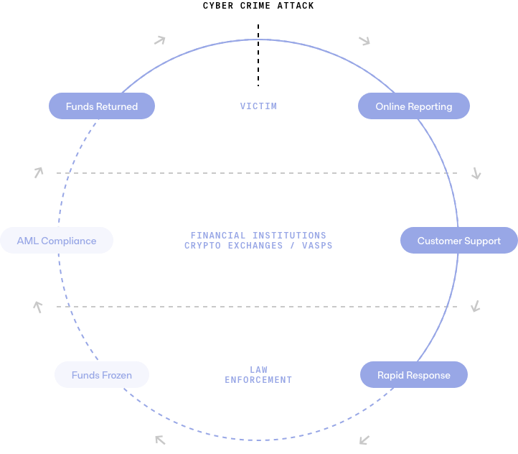
CYBERCRIME COMPLAINT™
Expert victim support
when your customers
need it most
Cybercrime reporting and coordinated global response to recover stolen funds
Customer Support
Fraud and scams hit your customers hard. How your business responds to these frauds can have a big impact on your reputation, as your customers turn to you for help.
Provide best customer experience for scam victims to increase your reputation and reduce legal costs.
Free up resources dealing with customer support.
Get streamlined insights and analytics regarding customers affected by scams and fraud to make informed decisions regarding financial cybercrime risks.
AML Compliance
Real-time payments have led to faster money laundering and the scale is huge. Respond in real time to the threats caused by mule accounts reducing abuse across the lifecycle.
Receive official criminal victim complaints immediately via our web portal or API.
Detect money laundering at your institution or crypto exchange to reduce risks faster.
Immediately usable information to trigger suspicious activity reporting and freeze funds.
Automation and cost reduction
Fraudsters are scamming your customers, but do you have the metrics you need or is this an operational nightmare? Relieve and improve your first line of defence, by using CYBERA CYBERCRIME COMPLAINTTM.
Provide victims with expert support services to help when they need it most.
Reduce costs via direct reporting to beneficiary banks and law enforcement along with gaining accurate metrics of the scope of scams to aid future investment strategies.
Fast reporting increases opportunities for funds being frozen for repatriation.
© CYBERA 2022

